Slide 1


A Two-Day Inter-College Cultural Experience
“A space to pause. A place to breathe. A celebration to belong.”
30 & 31st January 2026 @ JNTUH UCESTH, Hyderabad

Slide 2

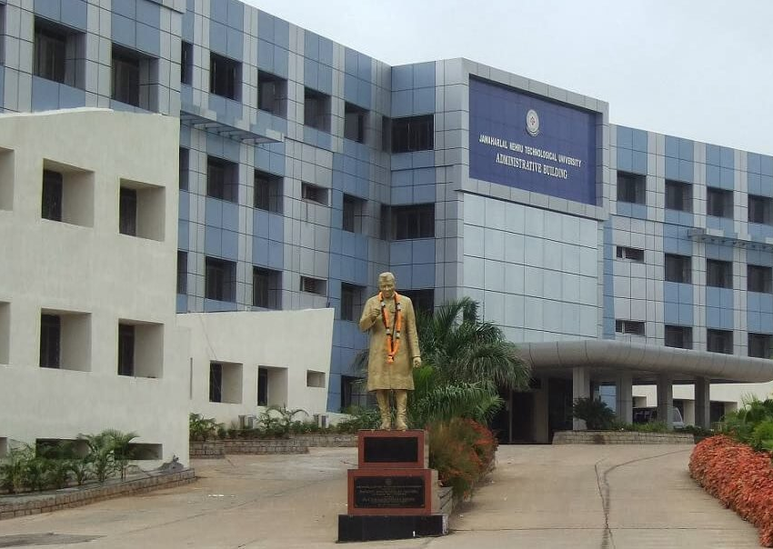
About The Institution (JNTUH)
Jawaharlal Nehru Technological University Hyderabad (JNTUH) was established in 1965 and transitioned into a technological university in 1972.
Located in Kukatpally, it serves as the state-affiliating university for Telangana, offering comprehensive programs in engineering, pharmacy, and management. Despite a 2008 restructuring that created several JNTU branches, JNTUH remains a premier institution, recently earning a NAAC ‘A+’ accreditation in 2024. With eight constituent colleges and six centers of excellence, it continues to lead advancements in research and technical education nationwide.

Slide 3



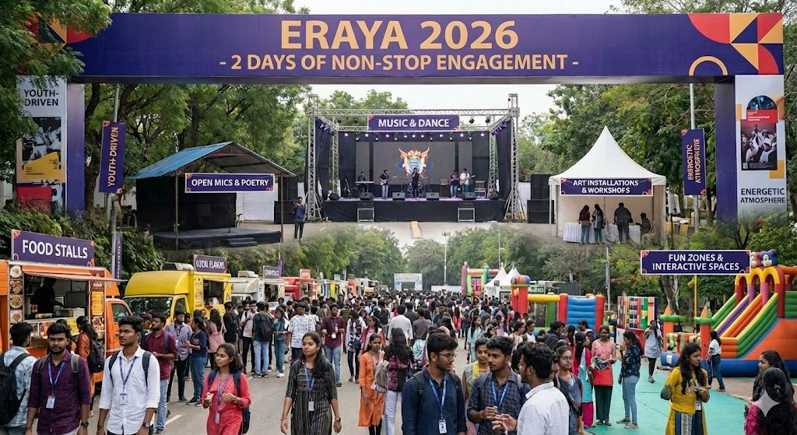

What is ERAYA 2026?
ERAYA 2026 is the first-ever large-scale cultural fest organised collectively by the student clubs of JNTUH, bringing together creativity, culture, and community

Slide 4
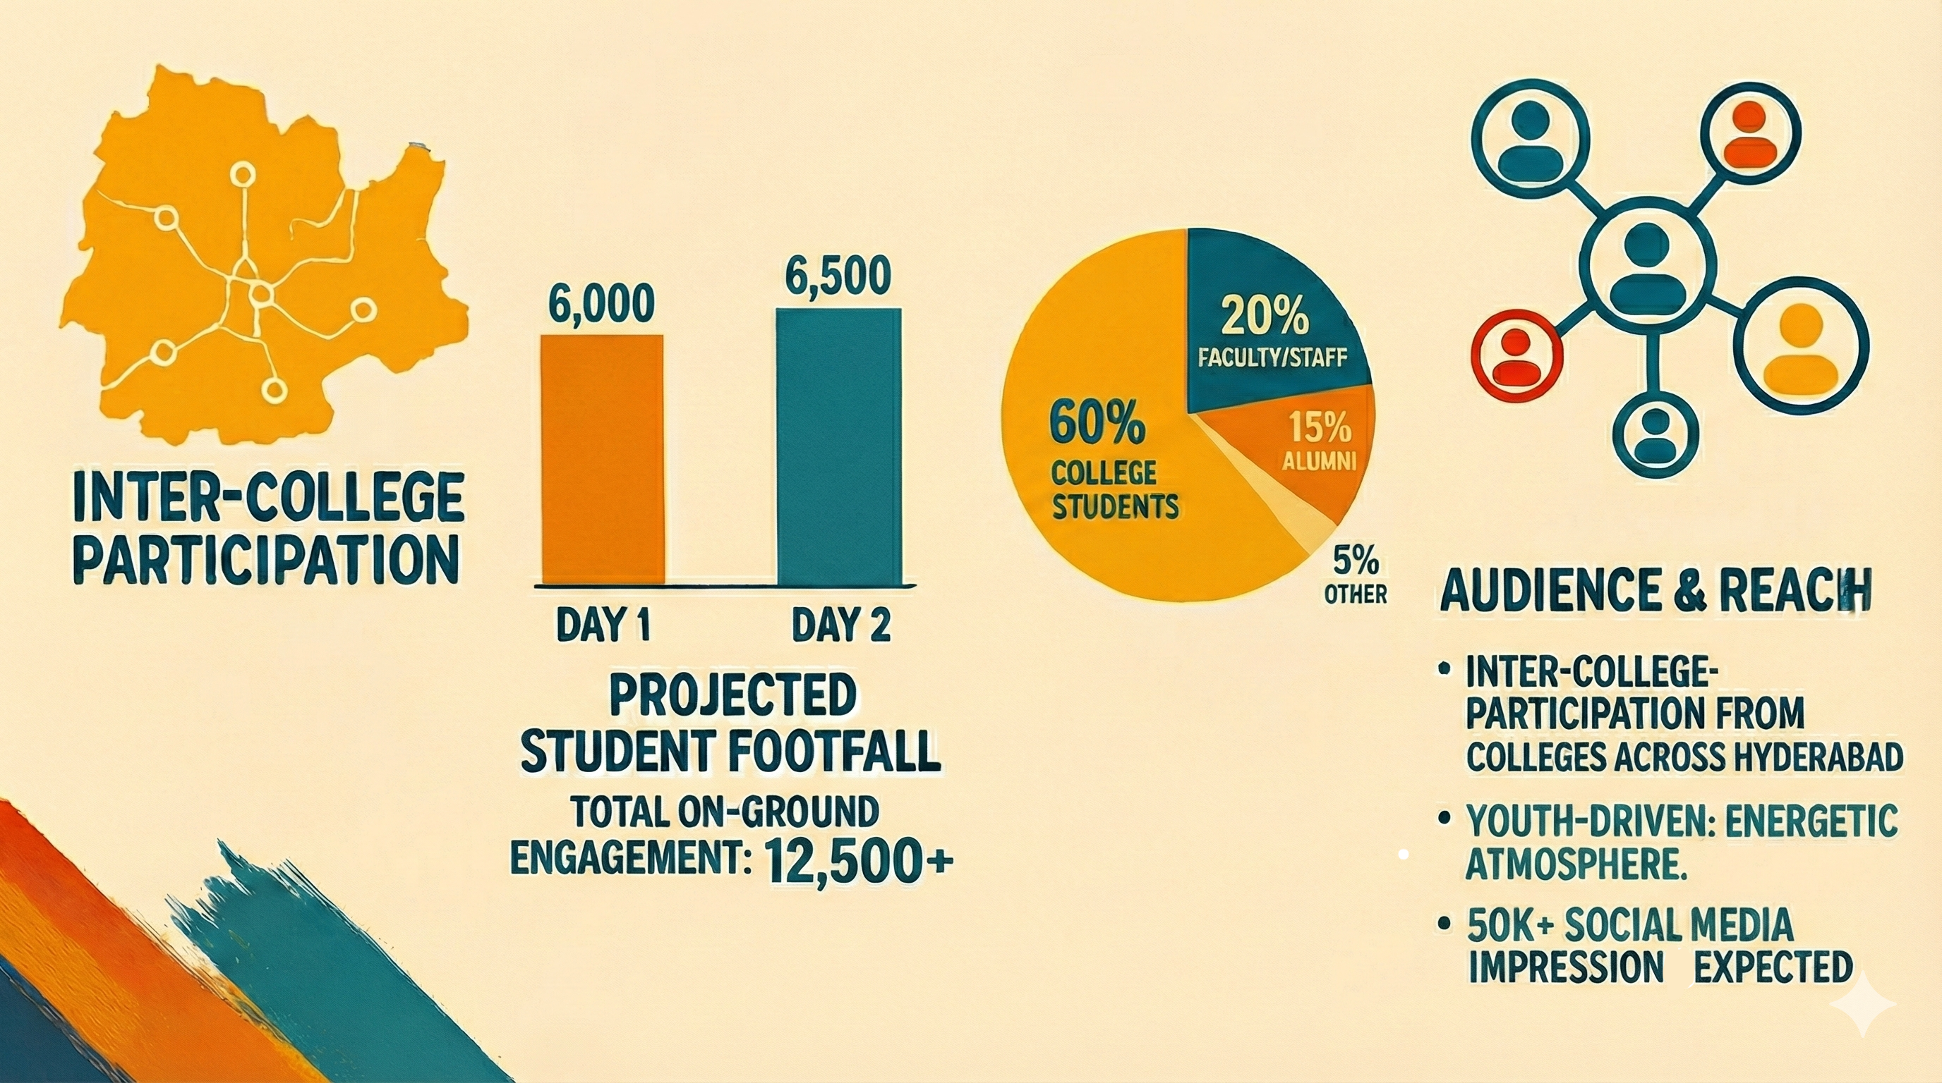
Audience & Reach
Connect with the Future
Engagement: 2 days of non-stop cultural engagement.
Demographics: Students, future professionals, creators, and decision-makers.
Footfall: Expected large student footfall from colleges across Hyderabad

Slide 5
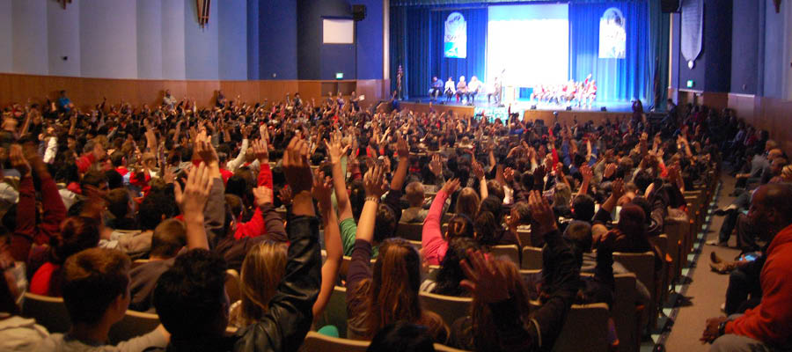

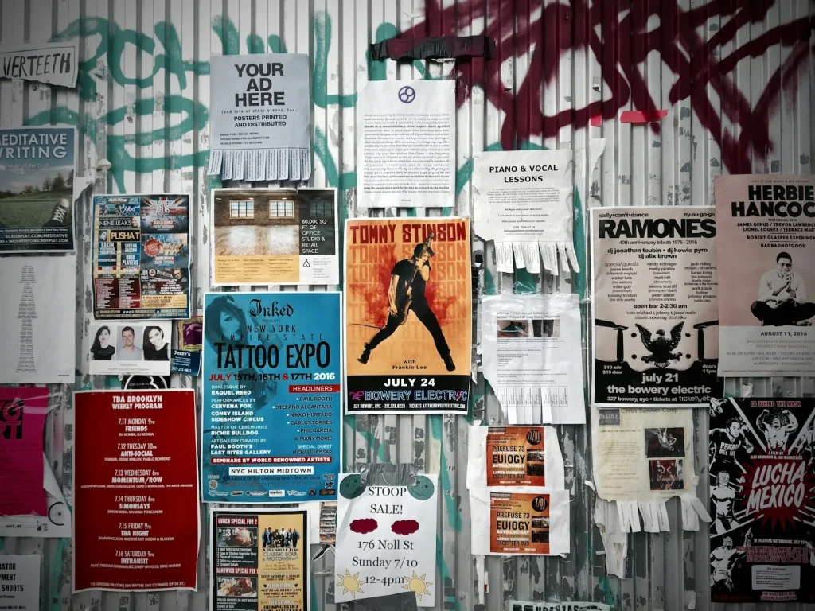


Why Partner With Us?
⚡ Massive Direct Reach Gain direct access to a large student audience comprising future professionals, creators, and decision-makers.
👁️ High-Impact Visibility Secure high on-campus brand visibility through premium hoarding space, stage mentions, and logo placement across all fest assets.
📱 Digital Amplification Extend your reach beyond the campus with extensive digital marketing and promotion across social media platforms.
🤝 Meaningful Engagement Move beyond just a logo, engage students directly through interactive brand sessions and dedicated sponsor stalls.
💰 Strategic Benefits Benefit from cost-effective campus marketing strategies that include applicable tax benefits.

Slide 6
Our Sponsorship Tiers
Note
Custom sponsorship packages can be designed on request
Platinum Sponsor
Contribution: ₹2,50,000 and above
Naming Rights: Fest powered by your Brand.
Collaboration: Joint venture with the Entrepreneurship Cell.
Branding: Premium hoarding and stage branding.
Digital: Extensive digital marketing across all platforms.
Engagement: Interactive brand sessions.
Recognition: Social event credits, logo on fest apparel, and logo on certificates & mementos.
Additional: Website promotion and tax benefits.
Gold Sponsor
Contribution: ₹1,50,000 and above
Branding: Event title sponsorship and promotional space on hoardings.
Digital: Digital marketing exposure.
Engagement: Interactive brand sessions.
Recognition: Social event credits and logo on fest apparel.
Additional: Website promotion and tax benefits.
Silver / Technical Sponsor
Contribution: ₹80,000 and above
Branding: Event title sponsorship and promotional space on hoardings.
Engagement: Interactive brand sessions.
Recognition: Social event credits.
Additional: Website promotion and tax benefits.
Other Sponsorship Options
T-Shirt Sponsor: ₹60,000
Flashmob Sponsor: ₹60,000
Stall & Advertisement in Souvenir: ₹30,000

Slide 7


Slide 8
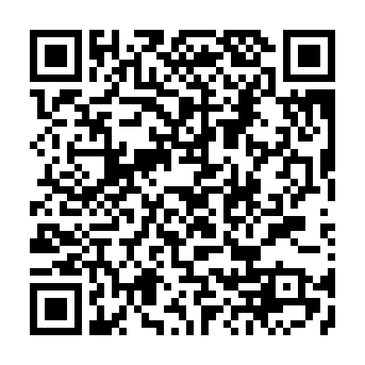
Contact Us
Gmail: festjntuh@gmail.com
Umme Ateeya: 8374285244
Rhutvich Sharma: 8500152754
Parthiv Kondeti: 9492099999

